Slide 1

Advanced JavaScript Concepts Made Simple
Master the core principles that power modern JavaScript development. From hoisting to currying, we'll break down complex topics into clear, practical explanations.

Slide 2

Hoisting: Variables and Functions Move Up
How It Works
JavaScript "hoists" declarations to the top of their scope before execution begins. This means you can call a function before it's defined in your code.
Key point: Only declarations are hoisted, not initialisations. Variables declared with var are hoisted but initialised as undefined, whilst let and const remain in a temporal dead zone.

Slide 3

Lexical Scope: Where Variables Are Accessible
Location Matters
Access Pattern
Variable Resolution
Inner functions can access variables from outer functions, creating a scope chain.
Scope is determined by where functions and blocks are written in your code, not where they're called.
JavaScript knows which variable to use in nested code by traversing up the scope chain.

Slide 4




Execution Context: The Environment of Code Running
1
Global Context
Created first when script loads; contains global variables and functions.
2
Completion
Function Context
Execution
Each function call creates its own context with local variables and scope.
Creation
3
Context Components
The execution context serves as the runtime environment where JavaScript code is evaluated and executed.
Includes variable environment, scope chain, and the this binding.

Slide 5


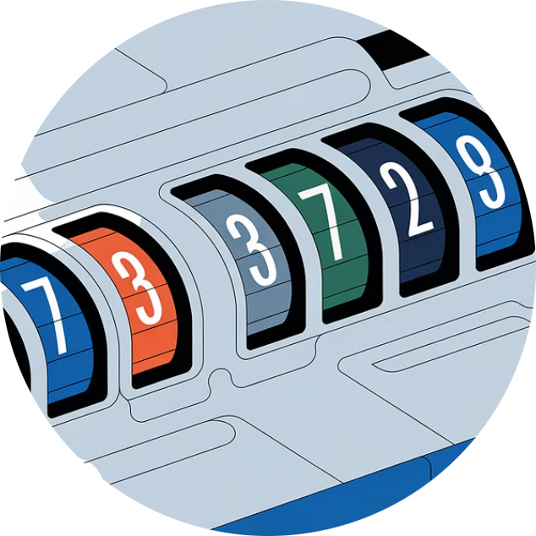
Closures: Functions Remember Their Scope
A closure is formed when a function retains access to its outer scope even after the outer function has finished executing. This powerful feature enables data privacy and functional programming patterns.
Private Variables
Data Persistence
Practical Example
Create variables that can't be accessed directly from outside.
Functions remember values from their creation environment.
A counter function that maintains its count across multiple calls.

Slide 6



Timers: setTimeout and setInterval
setTimeout
Executes code once after a specified delay in milliseconds.
setTimeout(() => {
console.log('Hello!');
}, 1000);
setInterval
Executes code repeatedly at fixed time intervals.
Common Use Cases
setInterval(() => {
updateClock();
}, 1000);
Animations and transitions
Delayed user interface updates
Polling for data changes
Auto-save functionality

Slide 7








Event Loop: How JavaScript Handles Asynchronous Tasks
The event loop is JavaScript's mechanism for handling asynchronous operations whilst maintaining single-threaded execution. It continuously checks the call stack and message queue to process tasks efficiently.
Check Call Stack
Check Queue
Is the stack empty?
Any tasks waiting?
Repeat
Execute Task
Continue the cycle
Move to call stack
This explains why timers and callbacks don't freeze the page—they're processed when the call stack is clear.

Slide 8


Single Threaded & Call Stack: One Thing at a Time
The Call Stack
JavaScript runs one command at a time using a single call stack. This stack tracks function calls in order, following a Last-In-First-Out (LIFO) pattern.
Stack Overflow: If the stack becomes too full (e.g., infinite recursion), you'll encounter a stack overflow error.
Function Called
Function Executes
Function Returns
Added to top of stack
Processes line by line
Removed from stack

Slide 9




Concurrency in JavaScript: Managing Multiple Tasks
JavaScript achieves concurrency through asynchronous patterns, allowing multiple operations to proceed without blocking the main thread. This keeps your UI responsive whilst handling background tasks.
Callbacks
Promises
Async/Await
Functions executed after async operations complete
Objects representing eventual completion of async operations
Syntactic sugar making async code look synchronous
Real-world example: Fetching data from an API whilst the user continues interacting with your application interface.

Slide 10
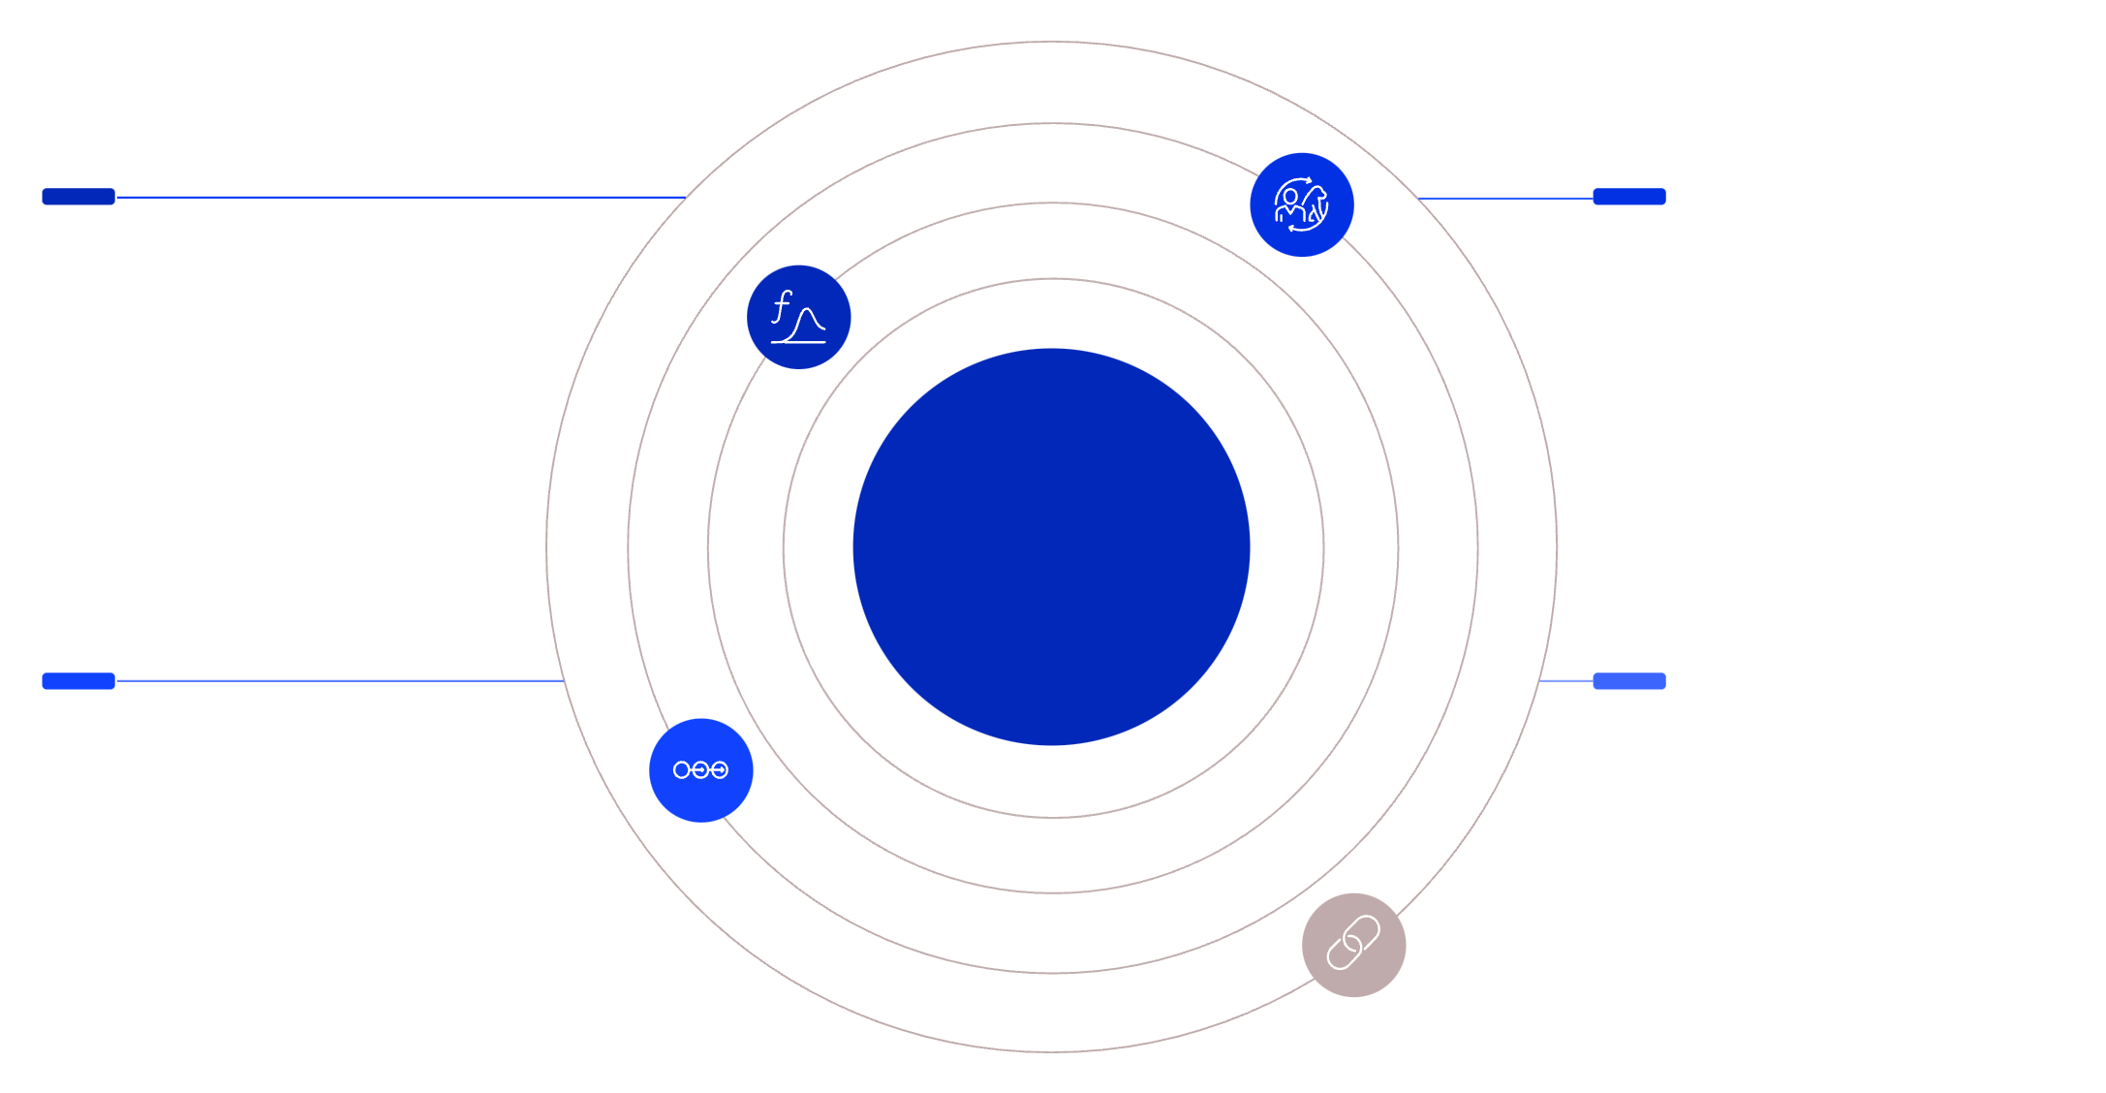




Currying: Breaking Functions into Smaller Pieces
Benefits of Currying
Reusability: Create specialised functions from general ones
Flexibility: Partial application of arguments
Composition: Build complex functions from simple ones
Multi-Arg Function
First Curry
Function f(x, y, z) with multiple parameters
Transforms to f(x) -> g(y, z) returning a function
Currying
Sequential Curries
Fully Curried
g(y) -> h(z) producing single-arg functions
Chain of functions each taking one argument
Example
const add = (a) => (b) => a + b;
const addTwo = add(2);
addTwo(3); // returns 5
Currying is a functional programming technique that transforms a function with multiple arguments into a sequence of functions, each taking a single argument.

